Slide 1
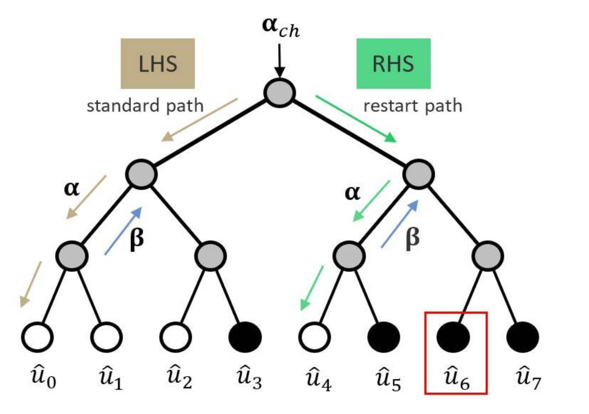
Polar codes
Mentor ta: Kalleda Partthu (202315003)
Group no: 1

Slide 2
honor code
We declare that
→ The work that we are presenting is our own work.
→ We have not copied the work (the code, the results, etc.) that someone else has done.
→ Concepts, understanding and insights we will be describing are our own.
→ We make this pledge truthfully. We know that violation of this solemn pledge can carry grave consequences.

Slide 3
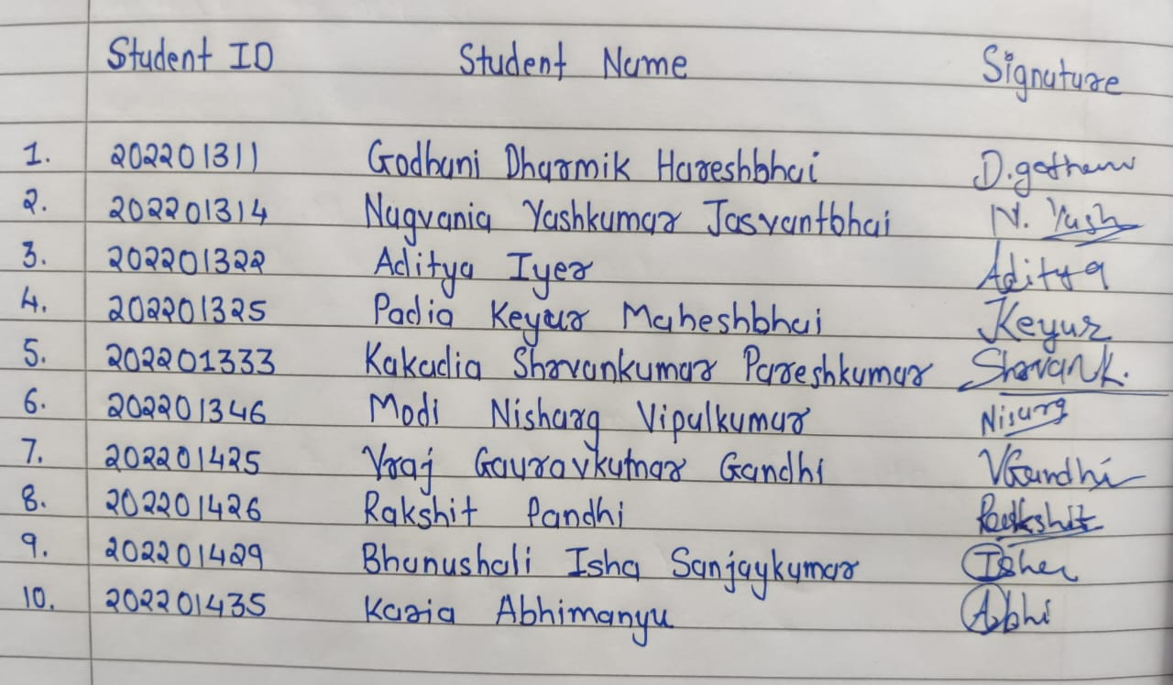
honor code

Slide 4
Objectives
Problem statement
What is polar codes?
Encoding of polar codes
Decoding of received polar coded signal
Successive Cancellation (SC) Decoding
Successive Cancellation List (SCL) Decoding
Performance results
References

Slide 5
Problem statement
In the realm of modern communication systems, achieving reliable and efficient data transmission over noisy channels remains a paramount challenge. Polar codes, a groundbreaking innovation in error correction coding, offer a promising solution. However, comprehensively understanding their performance and behavior through simulation is essential for practical implementation. Thus, this project aims to delve into the simulation of polar codes to evaluate their effectiveness in mitigating channel noise and enhancing data integrity.

Slide 6
What is polar code?
An idea to get benefit by polarization

Slide 7
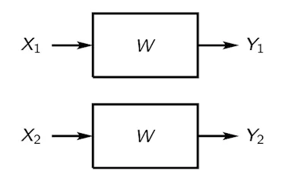
Can we polarize channels?
Binary Splitting is the input sequence getting divide into two halves.
Channel Combining is the process where pairs of channels are combined to form new channels with increased polarization.
Visualize this operation as connecting the outputs of two channels to form a new channel.
Bit channels can be polarized and can be ordered based on ‘quality’, from the worst to the best. It is very similar to Matthew’s Effect which says ‘the rich gets richer, and the poor gets poorer’.
[1.1] Bit sequence of two bits are divided into two halves and feed to channels.
Notes:
Polar code was firstly introduced by Erdal Arikan in 2008.
channel polarization is achieved through a process called channel combining, where pairs of channels are combined to form new channels with increased polarization. This process is repeated recursively until the channels become either highly reliable or highly unreliable.

Slide 8
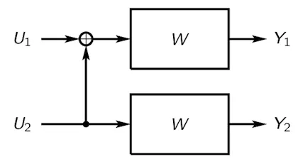
Can we polarize channels?
Binary Splitting is the input sequence getting divide into two halves.
Channel Combining is the process where pairs of channels are combined to form new channels with increased polarization.
Visualize this operation as connecting the outputs of two channels to form a new channel.
Bit channels can be polarized and can be ordered based on ‘quality’, from the worst to the best. It is very similar to Matthew’s Effect which says ‘the rich gets richer, and the poor gets poorer’.
[1.2] The input streams are combined to form new channels.
Notes:
Polar code was firstly introduced by Erdal Arikan in 2008.
channel polarization is achieved through a process called channel combining, where pairs of channels are combined to form new channels with increased polarization. This process is repeated recursively until the channels become either highly reliable or highly unreliable.

Slide 9
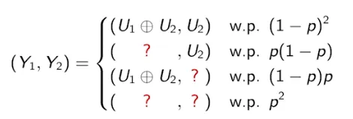
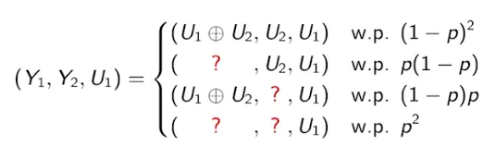
But how is it getting polarized as ‘Good’ and ‘bad’ channels?
We have created a W⁻ with the following characteristics:
U₁ is successfully decoded with the probability
(1-p)².
U₁ decode fails with the probability of p(1-p) + (1-p)p + p² =2p-p².
We have created a W⁺ with the following characteristics:
U₁ is successfully decoded with the probability (1-p)² + p(1-p) + (1-p)p = 1-p².
U₁ decode fails with the probability of p².
[1.3] It depicts all possible scenarios with respective probabilities.
[1.4] It shows if U1 is decoded completely then it turns the results the other way round.

Slide 10
But how is it getting polarized as ‘Good’ and ‘bad’ channels?
So, if W is BEC with erasure probability p = 0.3
Then, W⁻ has the erasure probability 2p-p² = 0.51 > 0.3.
And W⁺ has the erasure probability p² = 0.09, which is significantly lesser than 0.3
The probability of success is 0.49 and 0.91 for W⁻ and W⁺ channels respectively.
[1.3] It depicts all possible scenarios with respective probabilities.
[1.4] It shows if U1 is decoded completely then it turns the results the other way round.

Slide 11
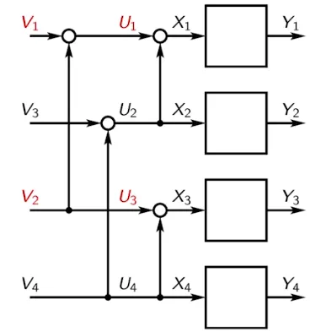
But how is it getting polarized as ‘Good’ and ‘bad’ channels?
We can cascade further to get 4 channels, then 8 and so on.
More the number n, the ‘good’ channels will better and ‘bad’ will get worsen,
[1.5] Cascading channels to get more polarized channels.

Slide 12
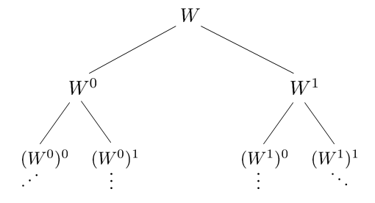
Binary tree representation
[1,6] Binary tree representation of a channel getting polarized, leftmost leaf node shows the worst channel, while rightmost leaf node shows the best channel.
We can further polarize channels to achieve extremely good and extremely bad channels.

Slide 13
Reliability sequence
Reliability sequence refers to a sequence of bits indicating the reliability of the encoded bits.
Reliability information helps in prioritizing which bits to decode first during the decoding process. Bits with higher reliability are decoded earlier, as they are considered to be more likely to be correct.
Reliability information can be obtained from various sources, such as channel quality estimates, signal-to-noise ratio (SNR) measurements, or other error probability metrics.
This information is then used to assign reliability values to each encoded bit, forming the reliability sequence.

Slide 14
encoding

Slide 15
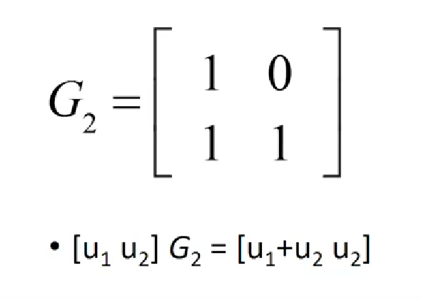
Encoding of polar codes
[2.1] A generator matrix G2, shown above, is used to encode bits.

Slide 16
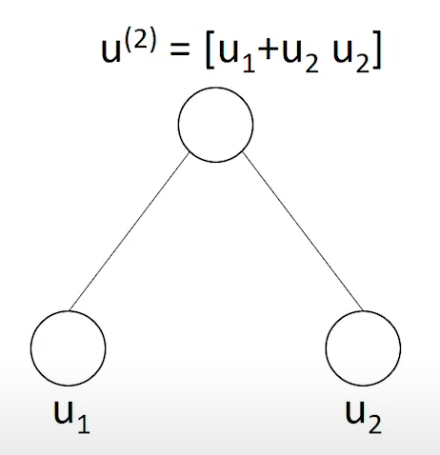
Encoding of polar codes
[2.1] A generator matrix G2, shown above, is used to encode bits.
[2.2] Binary tree representation

Slide 17
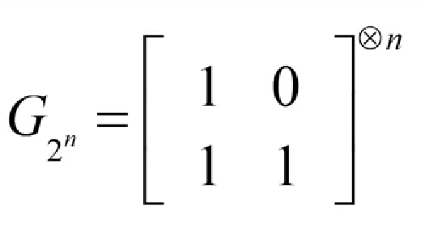
Encoding of polar codes
GN matrix is the n times kronecker product of G2 matrix.
You calculate the encoded message using GN matrix for n bit sequence {u1,u2, … un}
For n = 8, binary tree is shown in next slide.
[2.3] A general matrix to encode N = 2^n bits

Slide 18
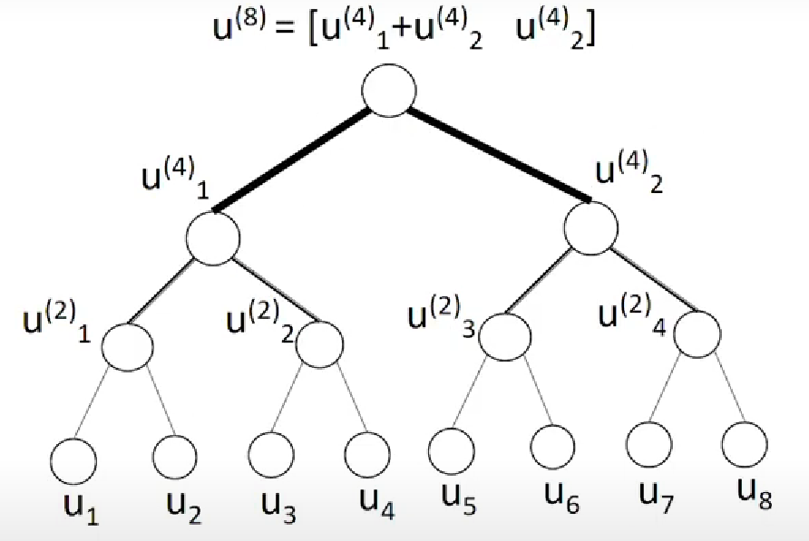
Picture [2.4]:Binary tree representation of encoding Picture [2.5]: Final message bits

Slide 19
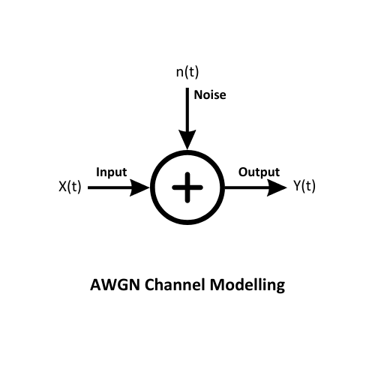
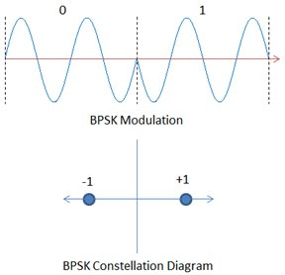
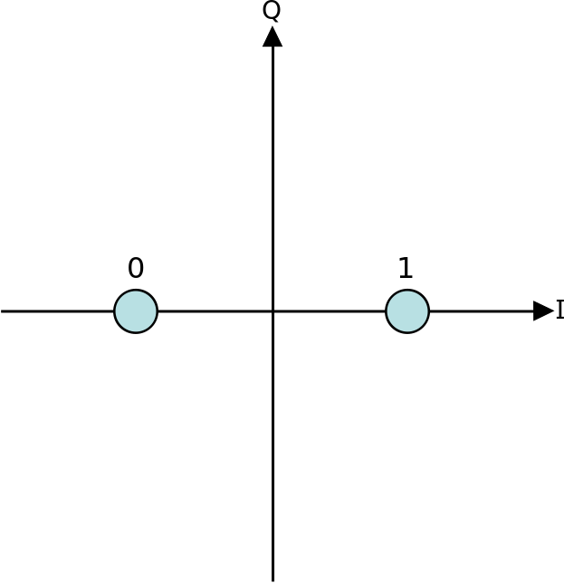
Bpsk and awgn
[2.6] BPSK modulation
Input Message Bits are sent through a BPSK modulator first. There are two probable outputs which have phase difference of 180 degrees, i.e. bit 0 gets assigned –1 and bit 1 gets assigned +1. Then the output of this modulator is given to an AWGN channel which adds Noise to the signal.

Slide 20
Decoding of received polar coded signal

Slide 21
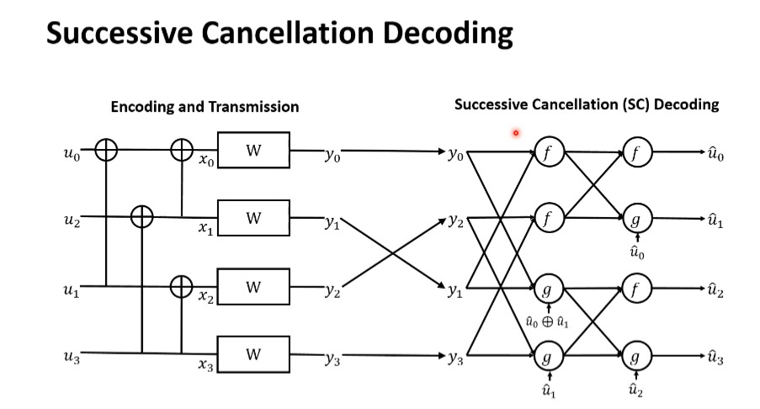
[3.1] Diagram showing encoding, transmission and successive cancellation(SC) decoding

Slide 22
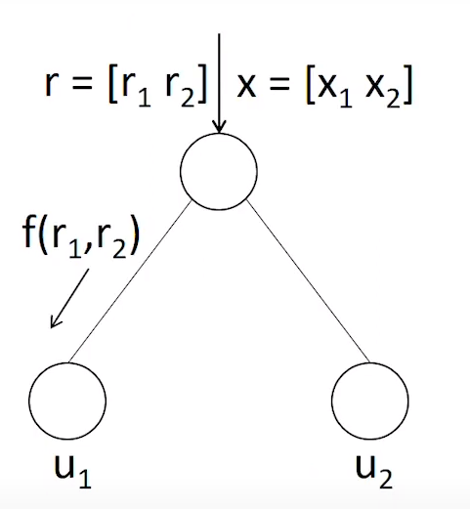
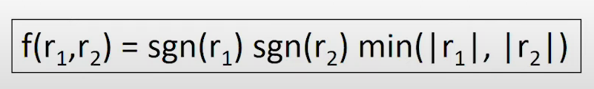
Belief propagation
In first step, consider a parent node asking for its left child value through a function written below.
[3.2] Receiving belief for left child node.

Slide 23
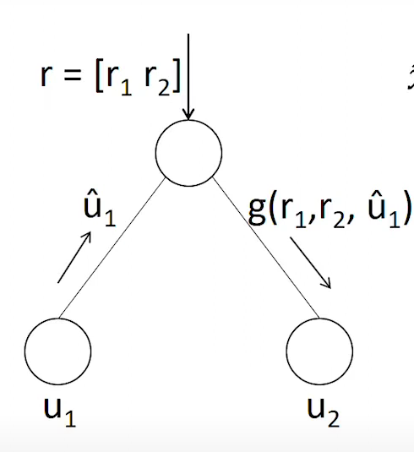

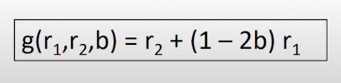
Belief propagation
In second step, you also repeat the process for the right child node but here you have the estimator for left child node bit value also taken into account.
[3.3] Receiving belief for right child node

Slide 24
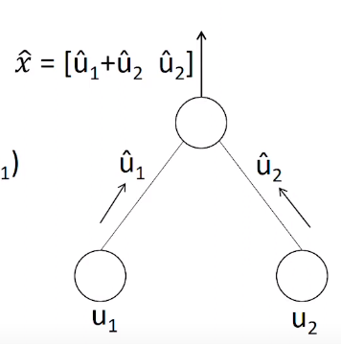

Belief propagation
In the third step, we send the estimated beliefs to upper node.
[3.4] Estimated bits are sent to grandparent node if exists.

Slide 25
Limitations of successive cancellation (sc) decoding
SC decoding is very powerful asymptotically, but its performance is not very competitive at moderate blocklengths.
Asymptotic complexity of SC decoding is O(N *logN) .
However, it is challenging to achieve high throughput due to limited parallelism.

Slide 26
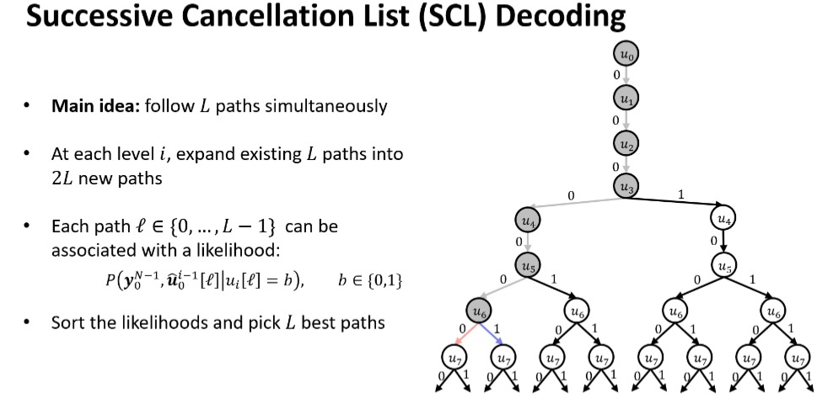
[3.5] A diagram which shows SCL decoding for 8 bits where {0,1,2,4} are frozen bits and {3,5,6,7} are message bits.

Slide 27
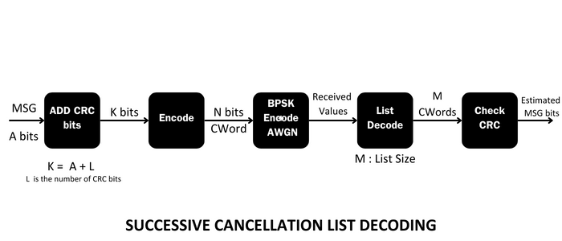
List Decoding, DM (Decision metrics) and PM (Path metrics)
Consider both decisions for each bit, i.e. assign DM as below
If L(ui) ≥ 0: ûi = 0 has DMi = 0, ûi = 1 has DMi = |L(ui)|
If L(ui) < 0: ûi = 1 has DMi = 0, ûi = 0 has DMi = |L(ui)|
IMPORTANT: DM assigned even if ‘i’ is frozen
[3.6] PATH METRIC : Sum of DM's over a path of choices

Slide 28
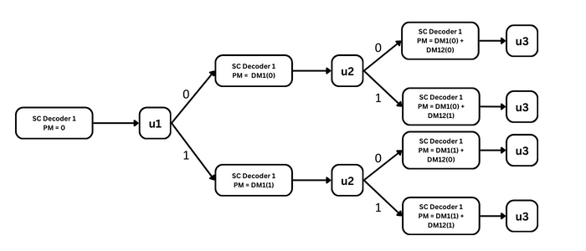
An Example of SCL with List size l = 4
When we have all the possibilities of u3 for the current case of L=4 list decoder we will have to make a decision to choose the best possible two possibilities of u3 and further do the same till we complete the decoding.
Picture [3.7]

Slide 29
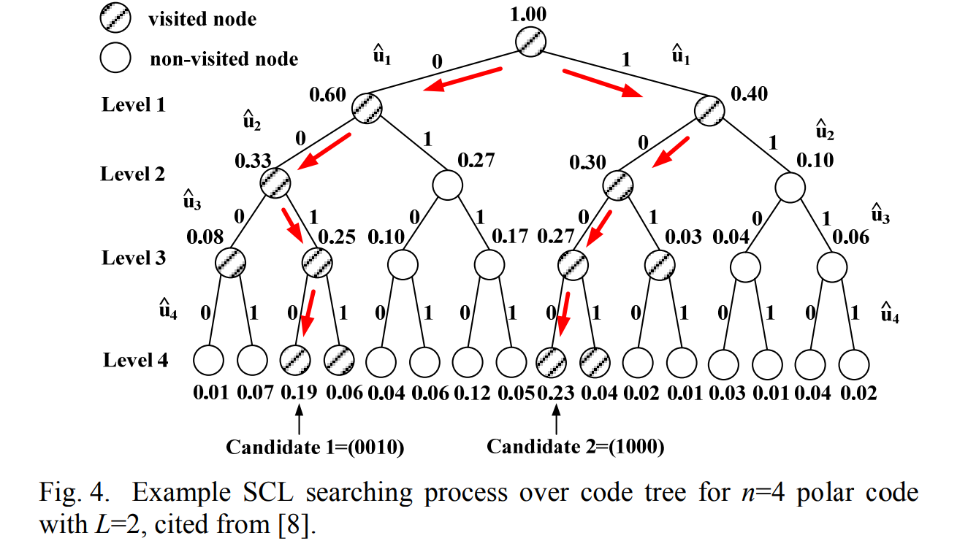
Taking decision on which paths to prune and which to keep
We will make decision according to the value of PM's of all the possible paths by choosing L/2 of those with the lowest PM's. Rest of the paths are pruned and not calculated further.
This operation is repeated over and over again till we have decoded all the N bits.
Picture [3.8]

Slide 30
Performance results

Slide 31
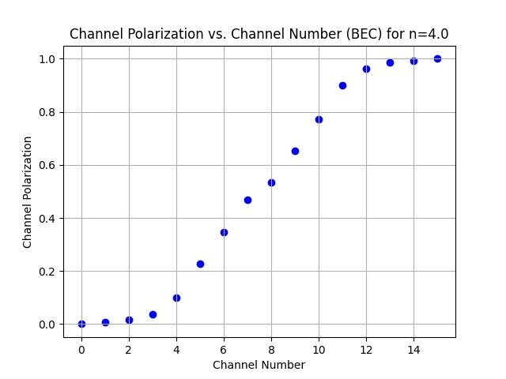
Channel polarization
[1.7] Channel polarization for n = 4, i.e 16 channels

Slide 32
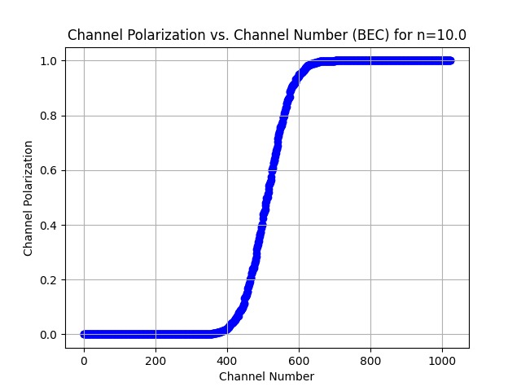
Channel polarization
[1.8] Channel polarization for n = 10, i.e 1024 channels

Slide 33
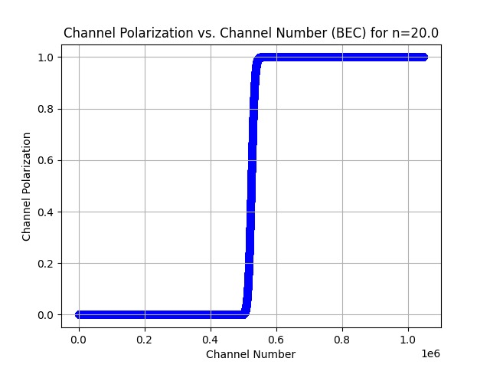
Channel polarization
[1.9] Channel polarization for n = 20, i.e around 1 M channels

Slide 34
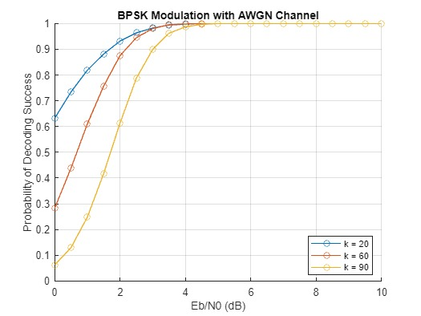
SC decoding
[3.5] For n = 128 and different k, probability of decoding success.

Slide 35
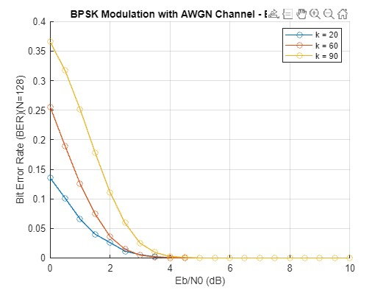
SC decoding
[3.5] For n = 128 and different k, probability of decoding success.

Slide 36
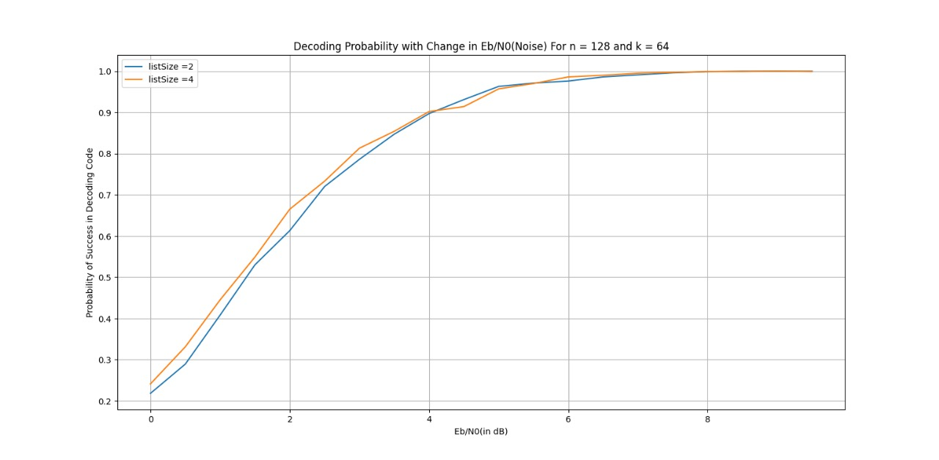
scl decoding
[4.1] Probability of success in decoding code for n=128 and k=64 and different listsize

Slide 37
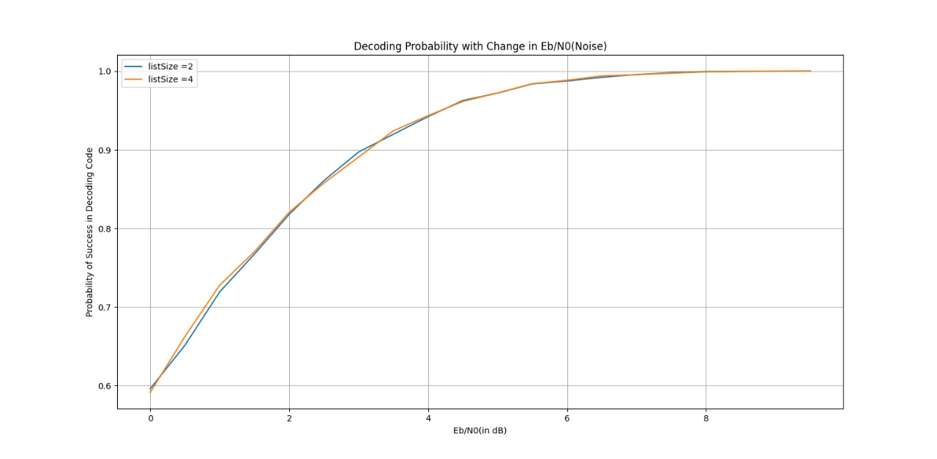
scl decoding
[4.2] Probability of success in decoding code for n=64 and k=32 and different listsize

Slide 38
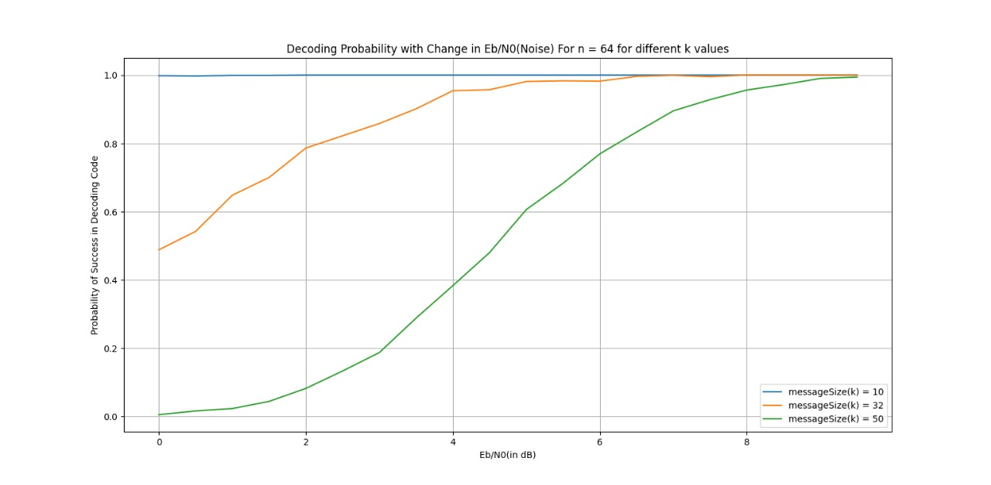
scl decoding
[4.3] Probability of success in decoding code for n=64 and different k and listsize = 4

Slide 39
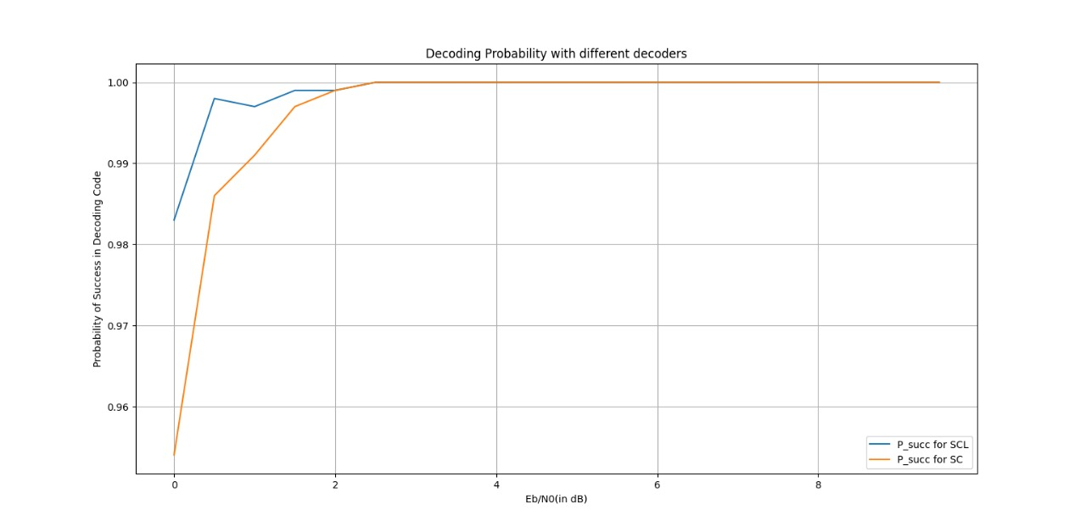
Comparing sc and scl decoding

Slide 40
conclusions
Polar codes, introduced recently in 2008, has potential to achieve Shannon’ channel capacity.
In October 2016, Huawei announced that it had achieved 27 Gbit/s in 5G field trial tests using polar codes for channel coding (Source: Wikipedia).
According to Wikipedia ” Polar performance can be improved with successive cancellation list decoding, but its usability in real applications is still questionable due to very poor implementation efficiencies caused by the iterative approach.”

Slide 41
Summary section
Polar code achieves high probability of ‘bit not getting erased’ by binary splitting and channel combining.
Polar codes encoded using generator matrix, which is Kronecker product of 2 x 2 kernel matrix.
For (n,k) polar code the least (n-k) reliable bits are kept frozen and other are used for transmission.
Decoding follows the iterative approach and asymptotically follows O(N * logN) time complexity.
List Decoding uses Path Metric(PM) and Decision Metric(DM), a soft decision decoding approach, and gives us a better performance than the decoding. Time complexity O(L * NlogN) but efficiency is greater than the decoding.

Slide 42
references
Cover Page picture taken from a website: https://www.etsmtl.ca/en/news/ecourter-lexecution-des-decodeurs-a-inversion-pour-codes-polaires
Pictures [1.1],[1.2],[1.3],[1.4] and [1.5] are taken from website of medium: https://medium.com/5g-nr/polar-codes-703336e9f26b
[1.6] from a website of ResearchGate: https://www.researchgate.net/figure/The-infinite-binary-tree-and-the-children-channels-after-the-polar-transformation_fig1_267213743
The idea for graphs [1.7],[1.8], and [1.9] are taken from Group 1 of Polar Codes under Nikita Mam.
[2.1],[2.2],[2.3],[2.4] are part of lecture of Prof. Andrew Thangraj, IITM: https://youtu.be/rB0rhQKyV34?si=-1sdgZZKdNC5VJL-&t=254
[3.1] video lecture at timestamp 36:01 on website of IEEE Information Theory Society : https://www.itsoc.org/video/efficient-decoding-polar-codes-algorithms-and-implementations
[3.2], [3.3] and [3.4] are part of lecture of Prof. Andrew Thangraj, IITM:: https://youtu.be/wK2KI2LtdQI?si=qPkgR_lXACWHUNpm&t=893
[3.9] Picture taken from research paper published by Bo Yuan and Keshab K. Parhi, Department of Electrical and Computer Engineering, University of Minnesota Twin Cities: https://arxiv.org/ftp/arxiv/papers/1411/1411.7282.pdf
A big thanks to group 2 and group 3 (under Bibin John sir) for helping in better understanding of SCL decoding.

Slide 43
THANK YOU !!

